Slide 1

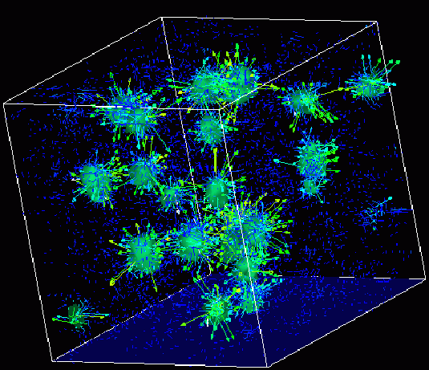

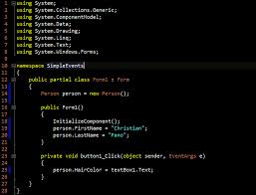
Survey of
Scientific Computing
(SciComp 301)
Dave Biersach
Brookhaven National Laboratory
dbiersach@bnl.gov
Exam 1
Total of 100 points

Slide 2

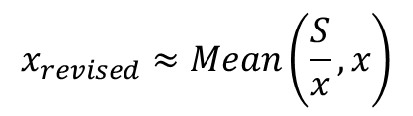
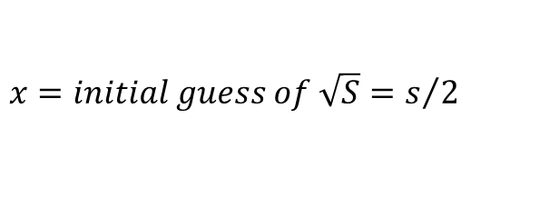

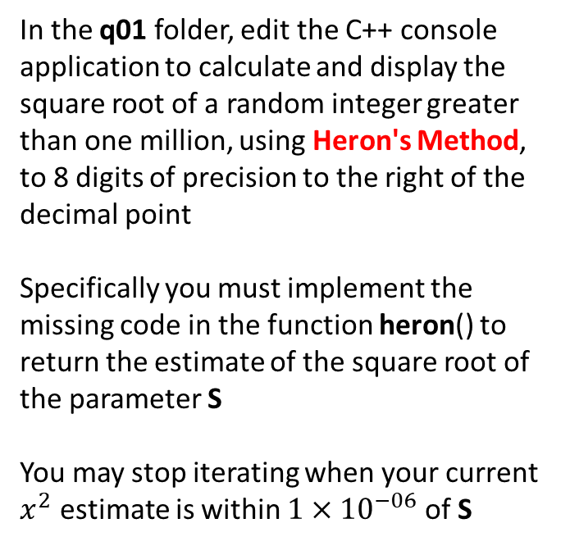
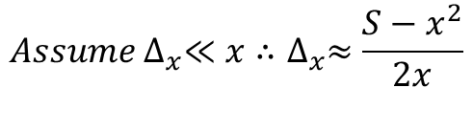

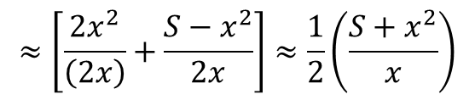

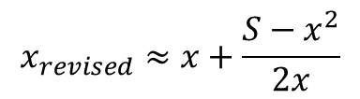
15 pts
1. Implement Heron’s Method
$$x=initial guess of \sqrt{S}=s/2$$
In the q01 folder, edit the C++ console application to calculate and display the square root of a random integer greater than one million, using Heron's Method, to 8 digits of precision to the right of the decimal point
Specifically you must implement the missing code in the function heron() to return the estimate of the square root of the parameter S
You may stop iterating when your current $x^{2}$ estimate is within ${1×10}^{−06}$ of S
$$S={(x+∆_{x})}^{2}=x^{2}+\left(2x\right)∆_{x}+∆_{x}^{2}$$
$$∆_{x}=\frac{S−x^{2}}{2x+∆_{x}}$$
$${Assume ∆}_{x}≪x∴∆_{x}≈\frac{S−x^{2}}{2x}$$
$$x_{revised}=x+∆_{x}$$
$$x_{revised}≈x+\frac{S−x^{2}}{2x}$$
$$≈\left[\frac{{2x}^{2}}{\left(2x\right)}+\frac{S−x^{2}}{2x}\right]≈\frac{1}{2}\left(\frac{S+x^{2}}{x}\right)$$
$$x_{revised}≈Mean\left(\frac{S}{x},x\right)$$

Slide 3
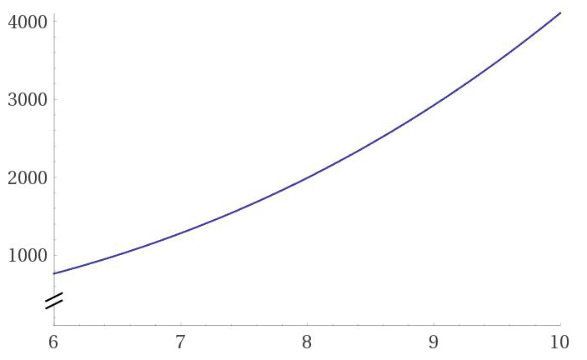
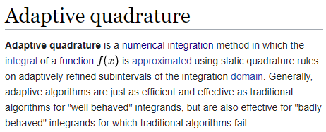
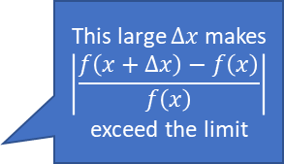

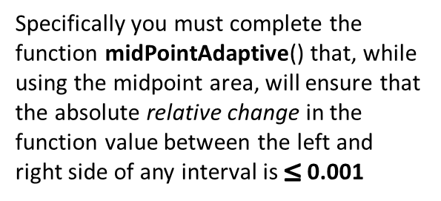
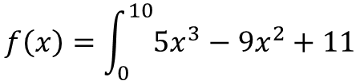



15 pts
2. Adaptive Quadrature
In the q02 folder, edit the C++ console application to calculate the following integral using the midpoint rule
$$f\left(x+Δx\right)$$
This large $∆x$ makes
$$\left|\frac{f\left(x+Δx\right)−f\left(x\right)}{f\left(x\right)}\right|$$
exceed the limit
$$f\left(x\right)$$
$$f\left(x\right)=\int_{0}^{10}{5x^{3}−9x^{2}+11}$$
$$Δx$$
Specifically you must complete the function midPointAdaptive() that, while using the midpoint area, will ensure that the absolute relative change in the function value between the left and right side of any interval is $≤$ 0.001
We need to reduce $∆x$ to keep the absolute relative change in the function value across the interval $≤$ 0.001
The function midPointFixed() is set to use 1 million fixed width intervals. How does the adaptive quadrature compare in terms of relative % error and overall execution time?

Slide 4
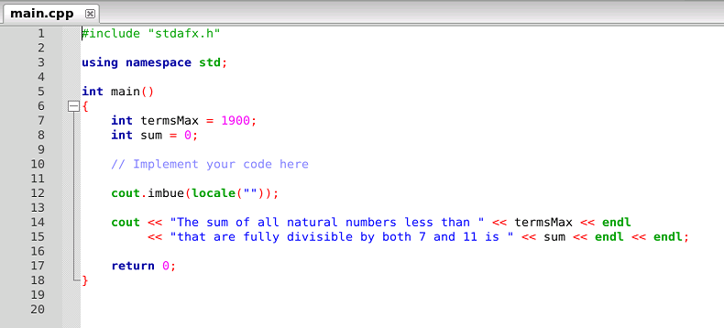
10 pts
3. Sum of Multiples
In the q03 folder, edit the C++ console application to calculate and display the sum of all natural numbers less than 1,900 that are fully (cleanly, evenly) divisible by both 7 and 11

Slide 5
5 pts
4. Temperature Converter
In the q04 folder, edit the C++ console application copied from Session 02 Lab 03 to display the same range in temperatures as before, but this time converting from Celsius degrees to Fahrenheit degrees
Be sure to make the human readable output make sense because you are flipping which scale is on which side of the equality symbol
Your code changes must successfully compile and run as expected

Slide 6
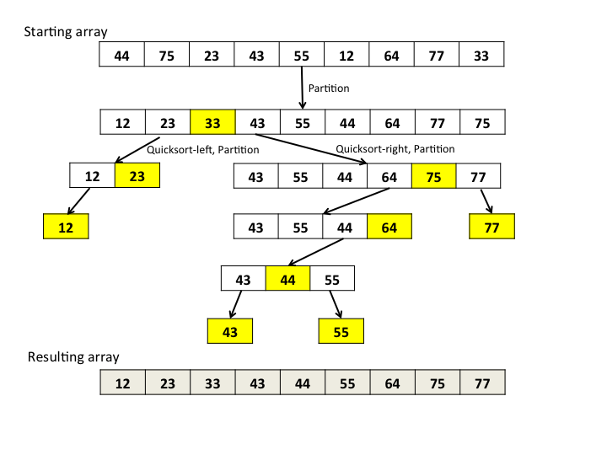

10 pts
5. Quicksort Optimization
Research Hoare’s Quicksort algorithm and understand the benefit of partitioning using the median of three for the pivot element - how does this effect the total run time?
In the q05 folder, edit the C++ console application to implement the MedianOfThree() function: a, b, c are the values, ai, bi, ci are the indexes
Your function should return the index
(ai, bi, or ci) corresponding to the median of the three values (a, b, or c)
The code initially is not using median of three. Run it as-is, then see how the total time changes once you implement the correct function.

Slide 7
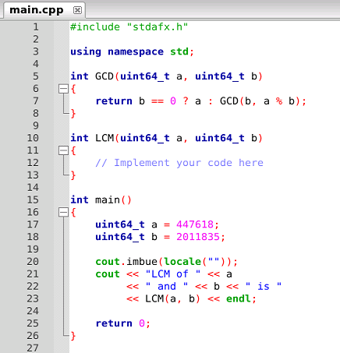
5 pts
6. Lowest Common Multiple
In the q06 folder, edit the C++ console application to calculate the lowest common multiple (LCM) of two integers a & b,
using only basic arithmetic operators (no looping) and the greatest common divisor (GCD) function which is already provided

Slide 8
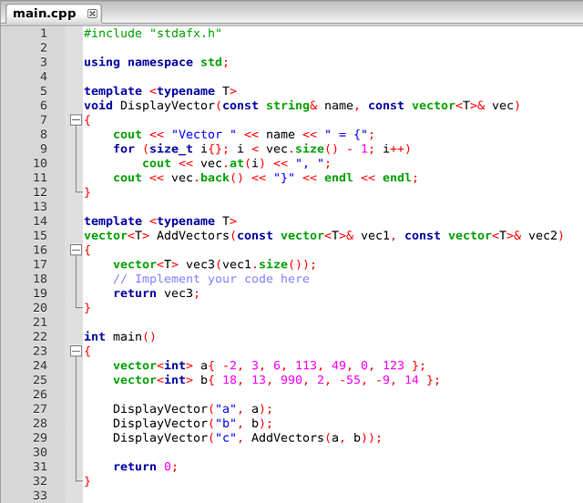
5 pts
7. Vector Addition
In the q07 folder, edit the C++ console application to calculate the addition of two vectors
In particular, complete the function SumVectors() by providing values for each element of vec3 using some form of looping construct

Slide 9
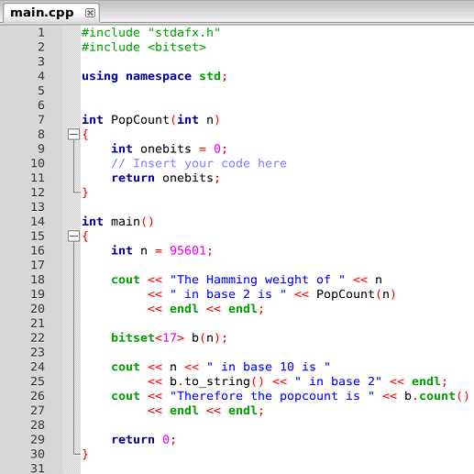
15 pts
8. Hamming Weight
In the q08 folder, edit the C++ console application to calculate the Base 2 Hamming Weight of a given natural number
You must write the correct code to find the PopCount() for the passed in variable n

Slide 10
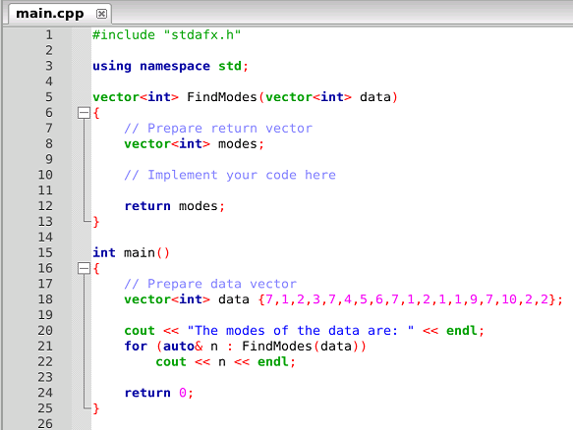
10 pts
9. Multimodal Sets
If two or more elements appear an equal number of times within a list, the list is said to be multimodal
In the q09 folder, edit the C++ console application to return all of the modes of a list
Specifically, you must implement the FindModes() function by populating the modes vector from the passed in data vector

Slide 11
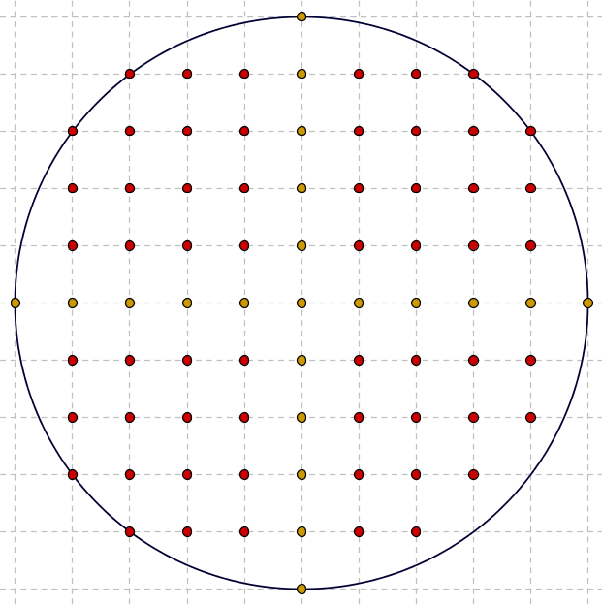

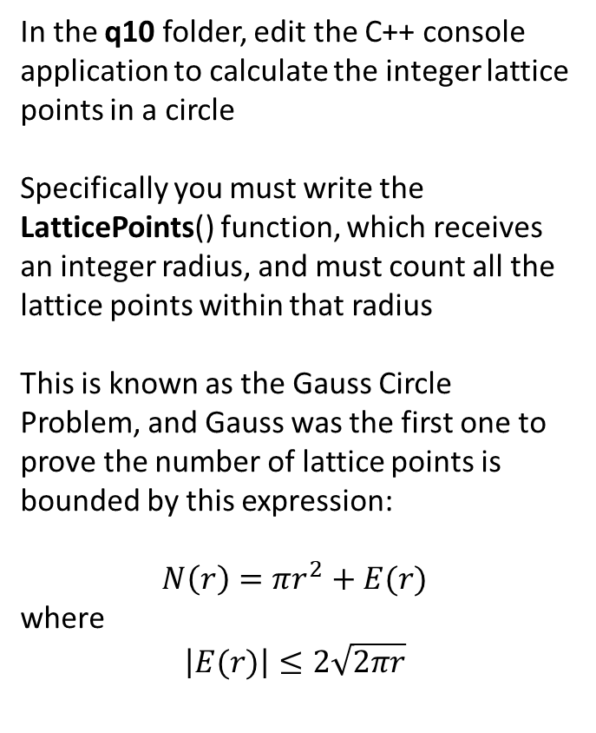
10 pts
10. Circle Lattice Points
In the q10 folder, edit the C++ console application to calculate the integer lattice points in a circle
Specifically you must write the LatticePoints() function, which receives an integer radius, and must count all the lattice points within that radius
This is known as the Gauss Circle Problem, and Gauss was the first one to prove the number of lattice points is bounded by this expression:
$$N\left(r\right)=πr^{2}+E(r)$$
where
$$\left|E(r)\right|≤2\sqrt{2πr}$$

